Slide 1

Business Analysis Portfolio Deck
AGRICULTURAL PRODUCT DISTRIBUTION SYSTEM
Prepared by: Pham Thi My Hanh | Business Analyst

Slide 2

Project vision
Digitalizing the end-to-end B2B agricultural distribution framework from central aggregation hubs to regional retail networks (Dealers).
Project Overview
Domain
Supply Chain, warehouse, logistics
Scope
Partner management (suppliers, dealers), order management, inventory, transportation, accounts receivable and payments.
Team size: 2 ( 1 BA & 1 Dev )
My Responsibilities
Conducted business process and requirement analysis.
Designed AS-IS / TO-BE workflows and BA documentation.
Created user stories, use cases, and wireframes.
Proposed operational improvement solutions.

Slide 3

Business Analysis Portfolio Deck
Manual Operations: Relying on Zalo/Phone/Excel leads to data fragmentation and order inaccuracy. | Inventory Blind Spots: Lack of batch/expiration tracking spikes fresh produce spoilage (15-20%).
Financial Friction: Delayed paper-based debt reconciliation locks up working capital | Lack of a transportation management system (TMS) and real-time order status update application.
BUSINESS PROBLEMS

Slide 4
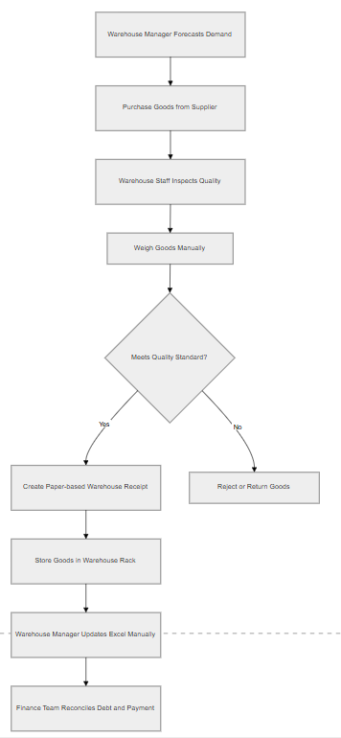
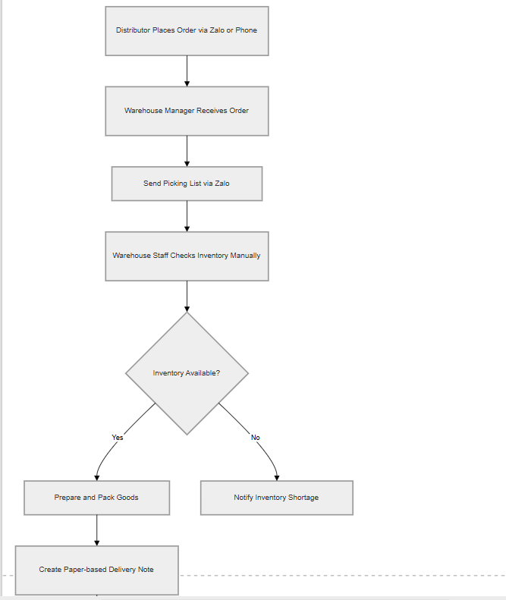
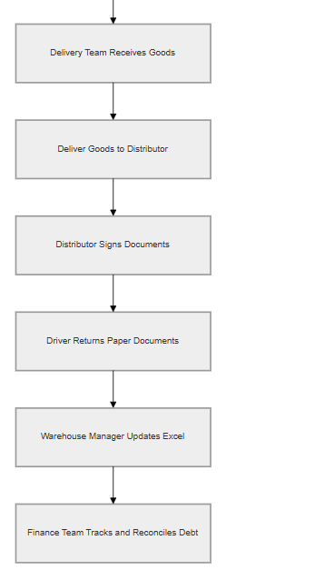
Business Analysis Portfolio Deck
AS-IS WORKFLOW

Slide 5
GAP ANALYSIS
GAP-01
Lack of a centralized data management system.
Very High
GAP-03
Risk of discrepancies in accounts receivable (debt) and financial data.
High
GAP-05
Delayed reporting and a lack of forecasting capability.
Medium
GAP-02
Manual inventory management process, leading to a high waste/loss rate.
Very High
GAP-04
Lack of real-time transportation monitoring capabilities.
Medium
GAP-06
Digital skill barriers among internal staff and external partners.
High

Slide 6

S | W | O | T
Established Network Deep Product Knowledge Well-Defined As-Is Processes | Legacy Management System High Inventory Loss Rate Communication Silos Poor Scalability | Digital Transformation Trends Growing Demand for Transparency Data-Driven Application | Fierce Competition Market Volatility and Natural Disasters Regulatory Compliance and Food Safety
Back

Slide 7

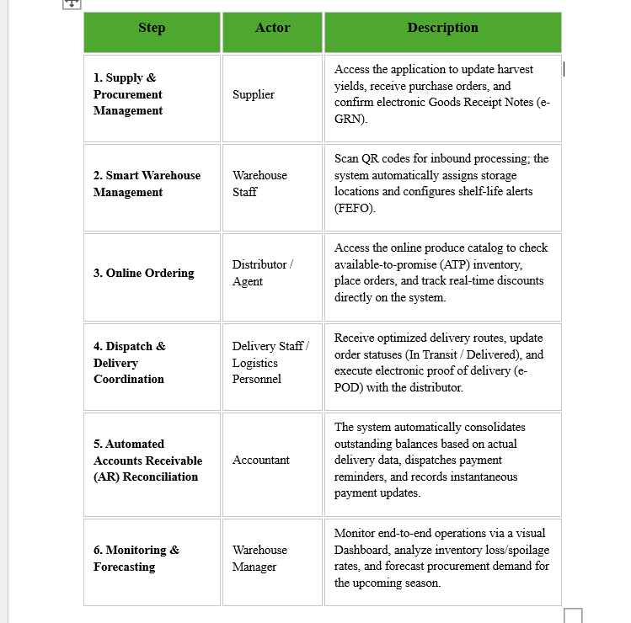
SUGGEST SOLUTION

Slide 8
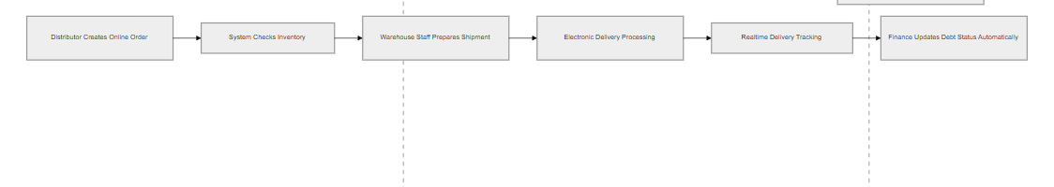
TO - BE WORKFLOW

Slide 9
Warehouse Operations
Support goods receiving, quality inspection, inventory classification, packing, and shipment preparation
Delivery Management
Coordinate shipment assignments, monitor realtime delivery tracking, and support electronic delivery confirmation
Procurement Management
Create purchase orders, monitor procurement status, approve inbound operations, and coordinate supplier deliveries
FUNCTIONAL SCOPE
Inventory Management
Monitor realtime inventory, track stock movement, generate low-stock alerts, and create electronic warehouse receipts
Order Management
Create distributor orders, verify inventory availability, process order status, and manage order workflows
Payment & Reconciliation
Track supplier and distributor debt, monitor payment status, synchronize financial records, and support automatic reconciliation

Slide 10
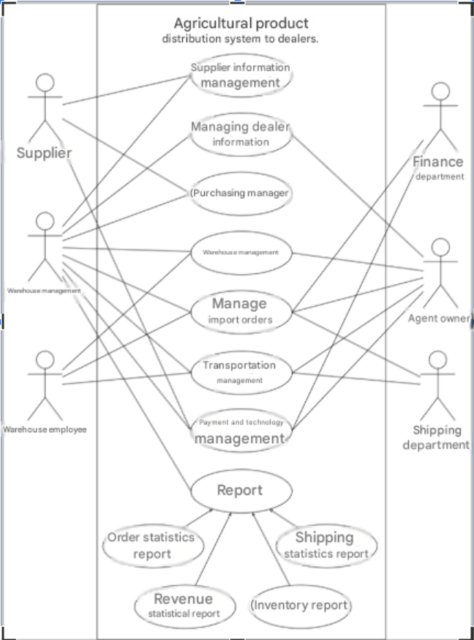
Business Analysis Portfolio Deck
USE CASE DIAGRAM
(GENERAL)

Slide 11
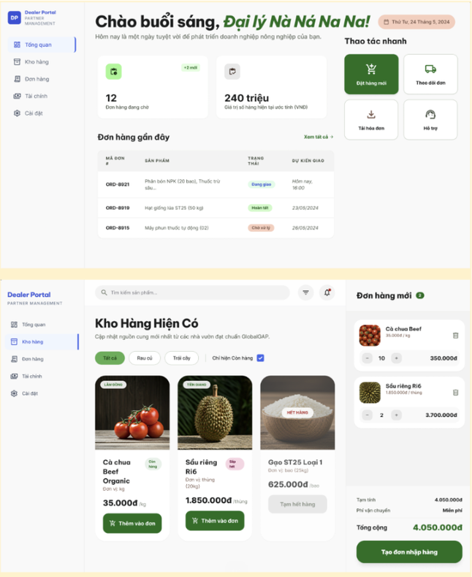
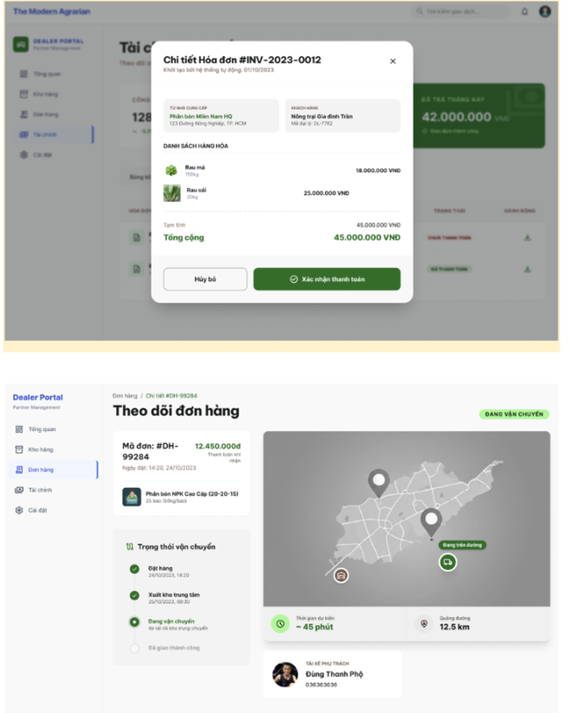
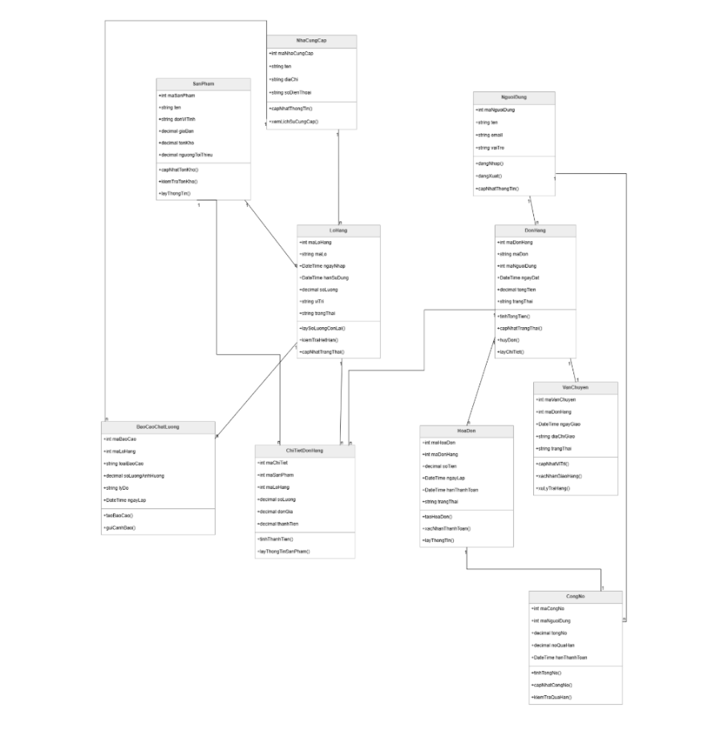
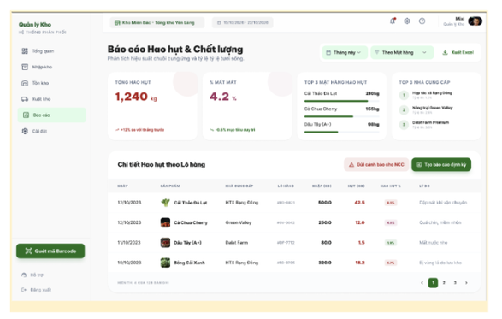
WIREFRAME SHOWCASE
Additional interface designs and interaction flows are available in the full project report
Quay lại Trang Chương trình

Slide 12
Business Value
Operational Risk Reduction
Business Value
& Operational Risk Reduction
Reduce manual workload and processing time
Improve operational efficiency through workflow automation
Increase realtime visibility across inventory and delivery operations
Enhance financial accuracy and reconciliation processes
Reduce inventory mismatch caused by manual tracking
Minimize paperwork and data entry errors
Improve delivery transparency and tracking visibility
Reduce delayed financial reconciliation and communication gaps

Slide 13





Key Takeaways
Improved operational efficiency
Enhanced realtime visibility
Reduced manual workflow dependency
Thank You for your time and attention
Sử dụng các tài nguyên thiết kế này trong Bản thuyết trình Canva của bạn. Thiết kế vui vẻ!
Hãy xóa trang này trước khi trình bày.

